Slide 1


Team 36: Mesh Walkie Talkies
Bi-Weekly Update 5 Cole Cieslewicz, Jaiah Steele, Junsu Yeo Sponsor: Giuseppe Rizzi TA: Niloofar Borzooei
Notes:
Michelle

Slide 2
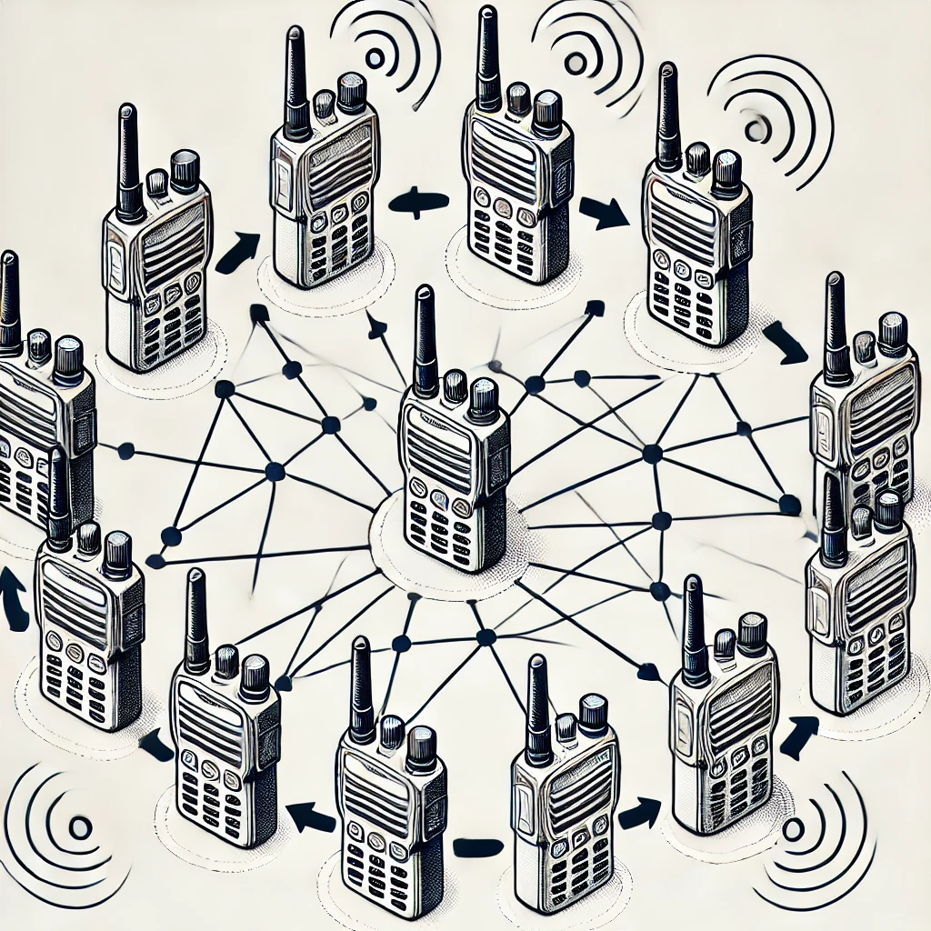
Project Summary
Conventional Walkie-Talkies:
Require close, limited communication
No network advantage
Our solution:
Mesh network to extend communication range and reliability.
Notes:
Kyle

Slide 3
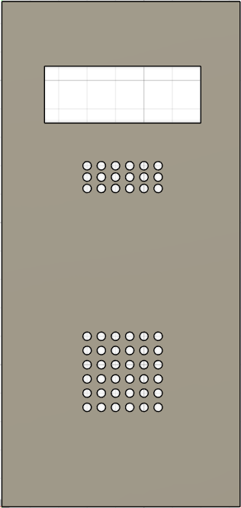

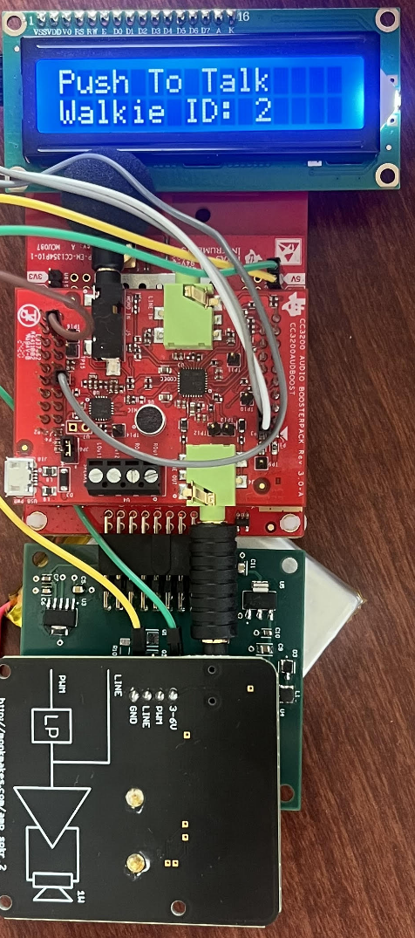

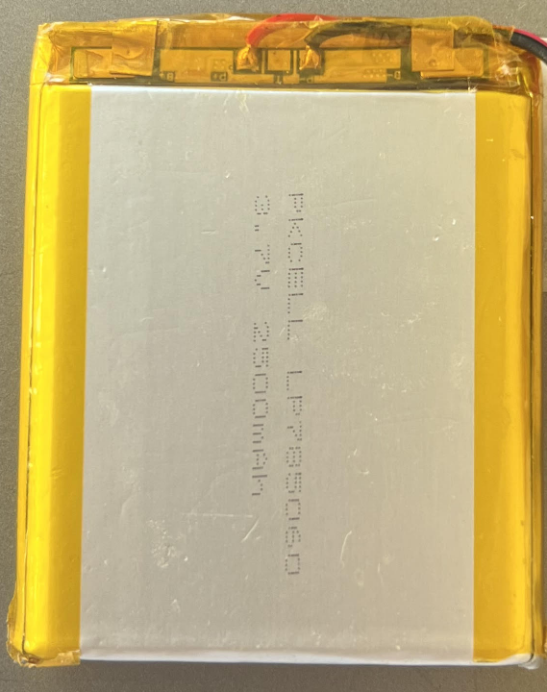
Integrated System Diagram
Notes:
Eric

Slide 4
Integrated System Diagram
Notes:
Eric

Slide 5
Integrated System Diagram
Notes:
Eric

Slide 6
Integrated System Diagram
Notes:
Eric

Slide 7
Project Timeline
Subsystem Designs and Testing (completed 1/31) | Integration of Power System and Launchpad (to complete by 2/26) | Integration of mesh network and audio (to complete by 3/5) | 3D printing walkie talkie case (to complete by 3/12) | Enclosing device and System Test (to complete by 4/02) | Validation (to complete by 4/16) | Demo and Report (to complete by 4/28)
Notes:
Eric

Slide 8
Mesh Audio
Jaiah Steele
Accomplishments since last update 30 hrs of effort | Ongoing progress/problems and plans until the next presentation
Validated unobstructed walkie-walkie line of sight non-mesh range (~150 meters). Range tested using power system PCB (Independent of PC USBC). Created sine wave alternating tone pattern with varying frequencies from sender to output on receiving walkie speakers. Investigated changing system configuration of PHY type. | Solve microphone -> audio processing/compression problems. Continue latency validation using packet send/receive RTC.

Slide 9
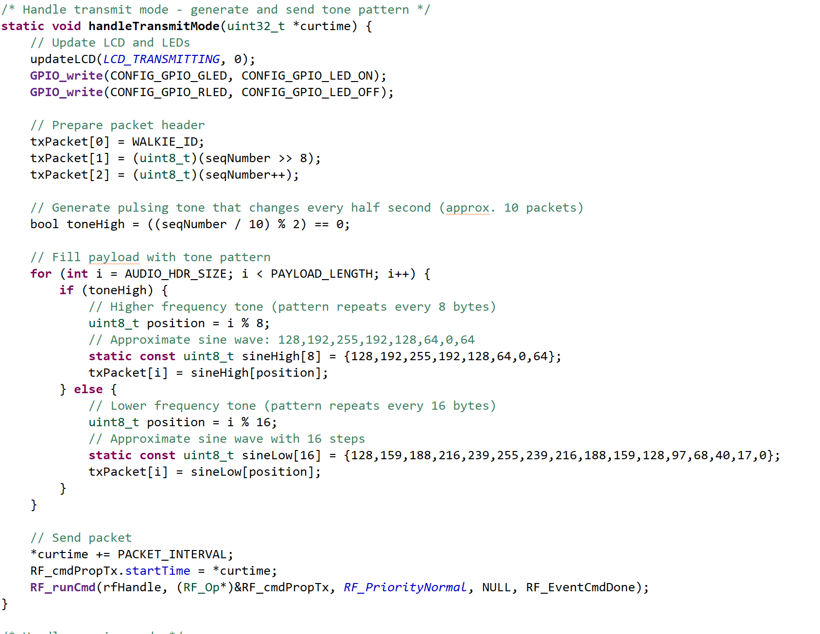
Mesh Audio
Jaiah Steele
Switches tone pattern every 10 packets (i.e., roughly every 0.4s if sending every 40ms).
Alternates between high-pitched and low-pitched tone.
A pulsing alternating tone is transmitted repeatedly over RF.
Receiving walkie-talkies can decode this as simple audio tones, helping test the audio transmission pipeline.

Slide 10
Mesh Audio
Cole Cieslewicz
Accomplishments since last update 25 hrs of effort | Ongoing progress/problems and plans until the next presentation
Created non-compressed transmission/reception code. Validated compression code, despite not being enough. Validated that audio code works in mesh system. Developing code to compress audio even further. | Debug present code that will allow audio transmission to be intelligible. Attempting new compression method. Latency validation.

Slide 11
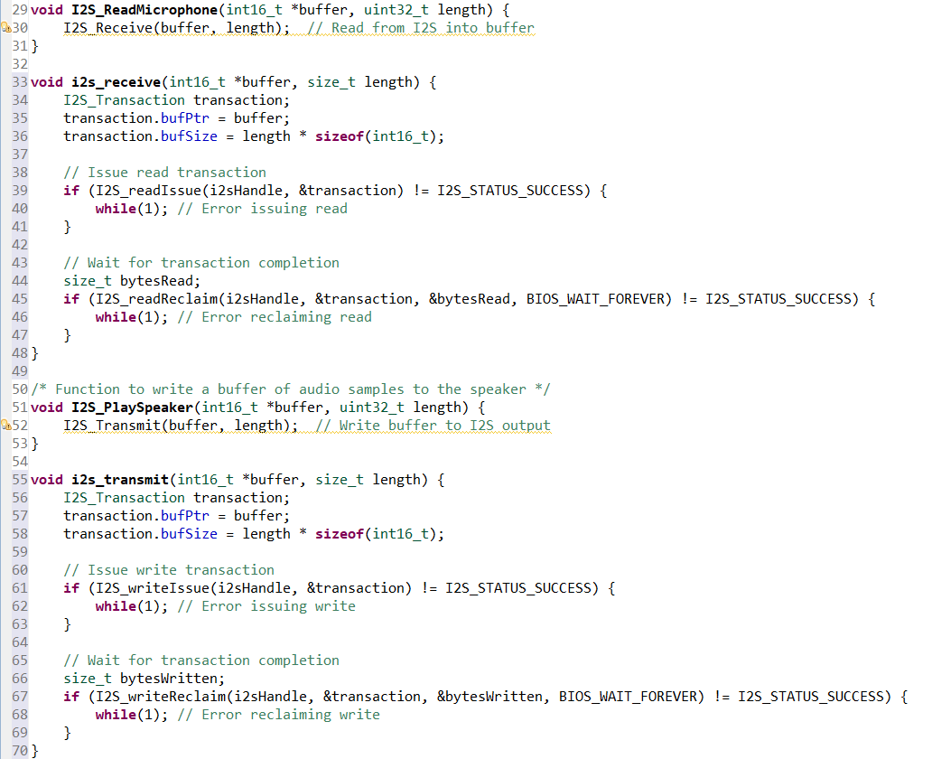
Mesh Audio
Code to read in from microphone, buffer it, packetize it, and vice versa for output.
Integrated with I2S driver.
Devices show blinking lights consistent with previous functionality, indicating correct function, but without any output

Slide 12
Power System
Junsu Yeo
Accomplishments since last update 15 hrs of effort | Ongoing progress/problems and plans until the next presentation
All validation and testing for power system was done before update 4. New PCB with the power switch works as expected. Put in a 3D print request at FEDC for Walkie Talkie Case. | Ensure the case fits everything and works as expected, make changes if needed. Finish assembly of 2 more PCBs. Final system testing with all components in the case.

Slide 13
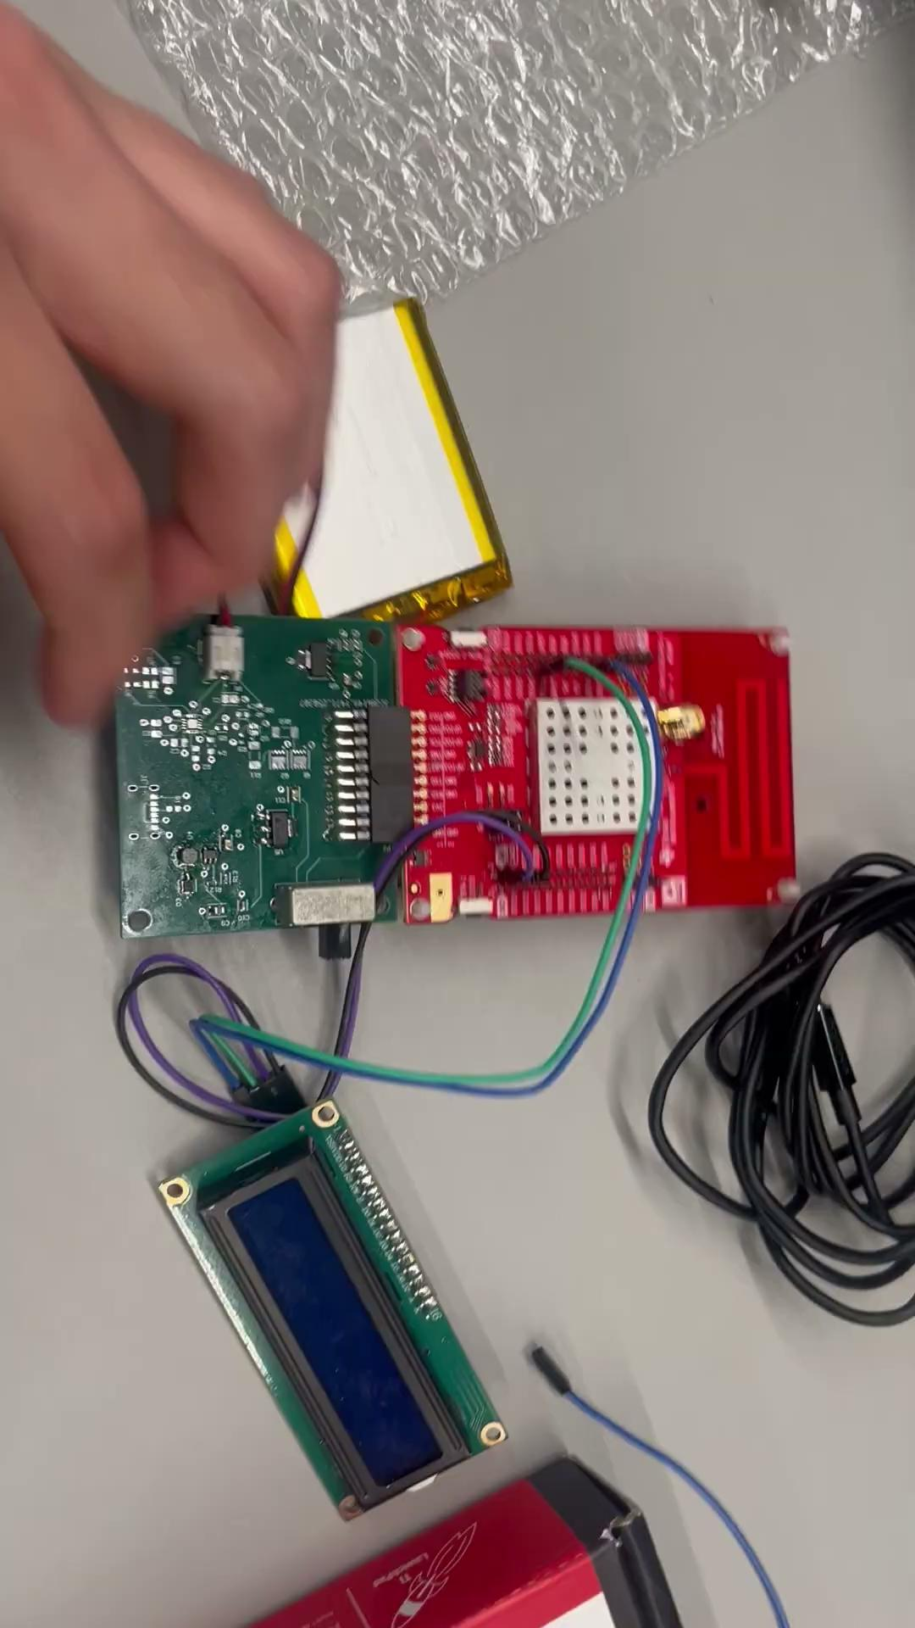
Power System
Junsu Yeo

Slide 14
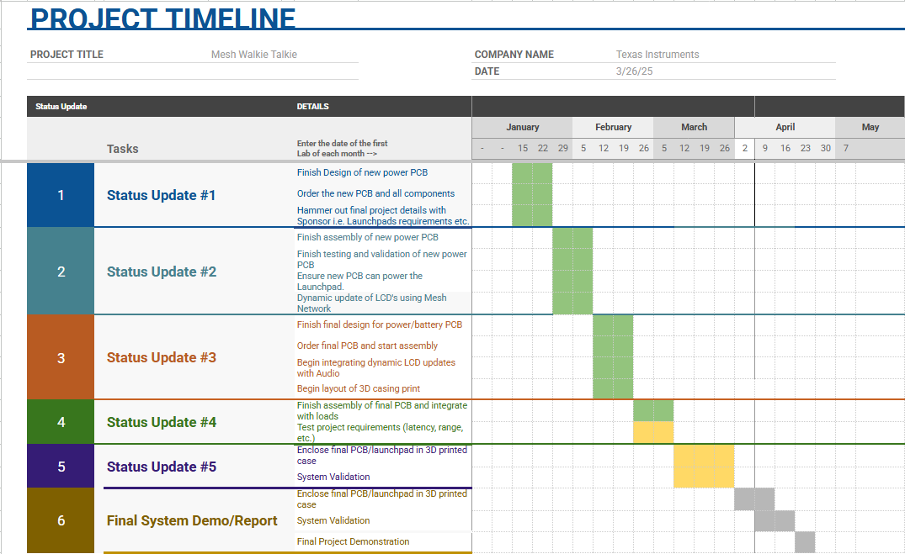
Execution Plan
Notes:
Michelle

Slide 15
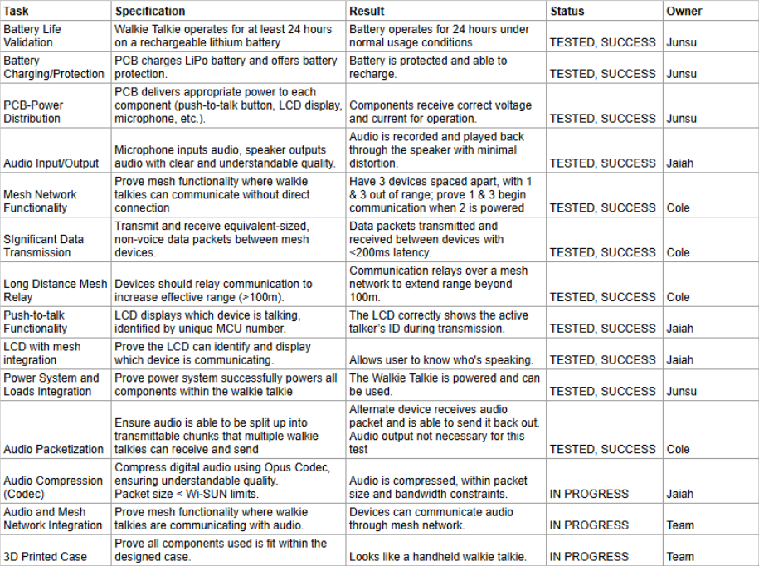
Validation Plan
Notes:
Michelle

Slide 16
Thank you!

